Slide 1

Trajectory of an Electron in Earth’s Magnetic Field
Ramagiri JAIDHAR - EP23BTECH11021
Y VENKAT RAGHAV - EP23BTECH11035
BONU VIDYA SAGAR - EP23BTECH11006

Slide 2
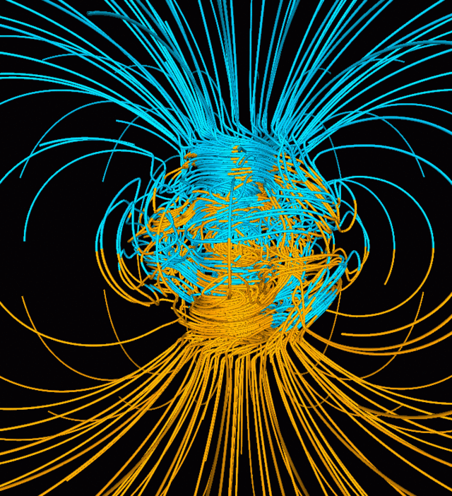
Aim of project
To find trajectory of moving electron under Earth’s magnetic field
Using Magnetic Velocity Verlet Method
Initial conditions given:
Electron with 30kev energy starts moving at magnetic equatorial plane at 1Re altitude above earths surface.
Velocity is on northeast direction(45° between north and east)

Slide 3
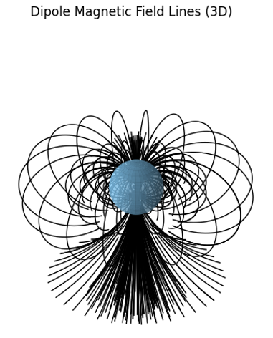
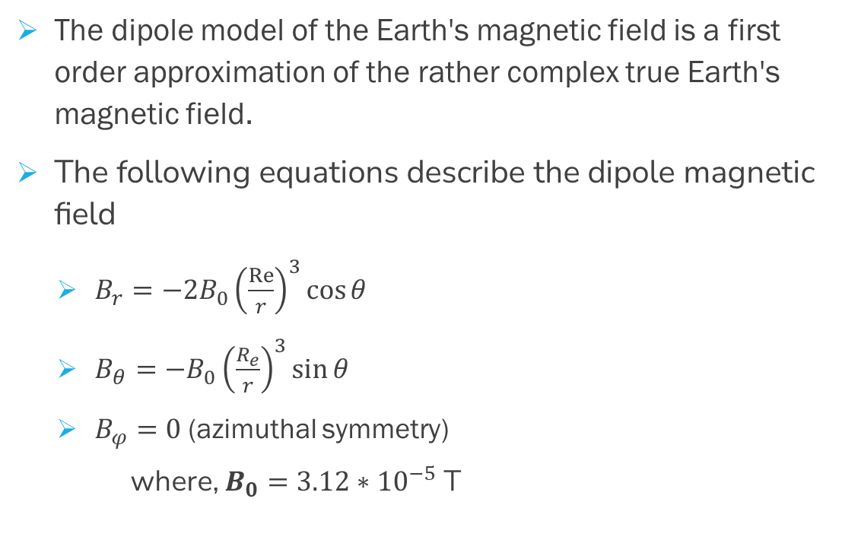
Earth’s magnetic Field
The dipole model of the Earth's magnetic field is a first order approximation of the rather complex true Earth's magnetic field.
The following equations describe the dipole magnetic field
$B_{r}=−2B_{0}{\left(\frac{Re}{r}\right)}^{3}\cos{θ}$
$B_{θ}=−B_{0}{\left(\frac{R_{e}}{r}\right)}^{3}\sin{θ}$
$B_{φ}=0$ (azimuthal symmetry)
where, $B_{0}=3.12∗{10}^{−5}$ T

Slide 4
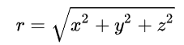
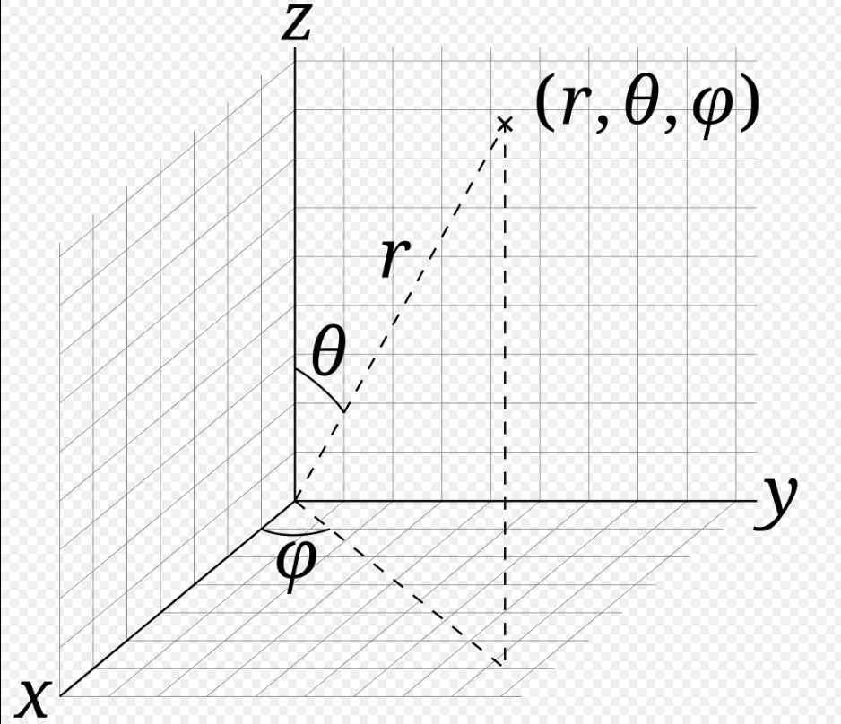
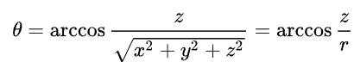
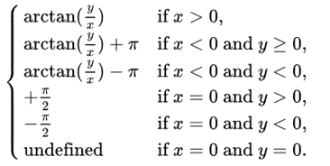
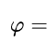
Converting polar coordinates to cartesian coordinates
r is position of particle and from distance formula is given by
Theta (θ) is the angle between z axis and the radial line and is given by
Phi(Ф) is the angle of rotation, which is angle between x axis and projection of radial line on x-y plane and is given by
This function is given by arctan2(φ) in computational methods.

Slide 5
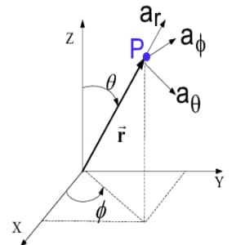
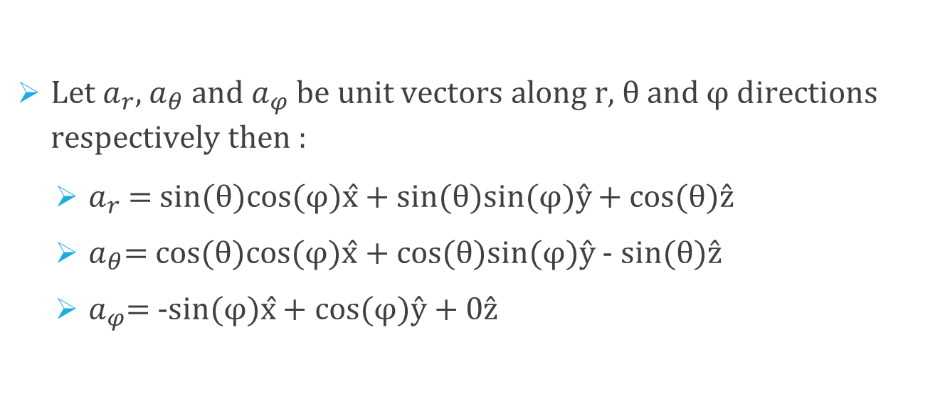
Converting polar coordinates to cartesian coordinates
Let $a_{r}$, $a_{θ}$ and $a_{φ}$ be unit vectors along r, θ and φ directions respectively then :
$a_{r}$ = sin(θ)cos(φ)x̂ + sin(θ)sin(φ)ŷ + cos(θ)ẑ
$a_{θ}$= cos(θ)cos(φ)x̂ + cos(θ)sin(φ)ŷ - sin(θ)ẑ
$a_{φ}$= -sin(φ)x̂ + cos(φ)ŷ + 0ẑ

Slide 6
Intro to Verlet
Verlet Integration is a numerical method used to integrate Newton’s equations of motion.
It is frequently used to calculate trajectories of particles in molecular dynamics simulations and computer graphics.
The Verlet integrator provides good numerical stability.

Slide 7
history
The Verlet algorithm was first used in 1791 by Jean Baptiste Delambre and has been rediscovered many times since then.
Most recently, it was used by Loup Verlet in 1960s for Molecular Dynamics.
It was also used by P.H.Cowell and A.C.C.Crommelin in 1909 to compute the orbit of Halley’s Comet.
In 1907, Carl Stormer used it to study the trajectories of electrical particles in a magnetic field (hence it is also called Stormer’s method).

Slide 8
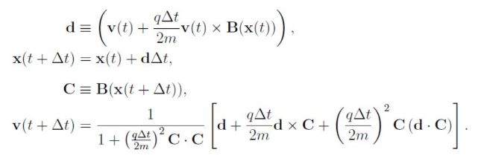
Magnetic velocity Verlet method
The traditional verlet method is
But this cannot be used because acceleration in this case depends on velocity and not only position.
Therefore Magnetic Velocity Verlet Method is used which is given by

Slide 9
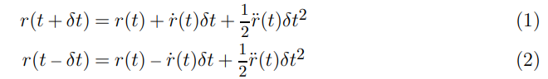
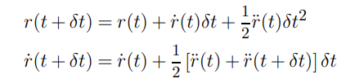
The standard Verlet algorithm is:
Adding these together, we get
It’s inconvenient to carry two sets of positions (at t and t − δt) so, we prefer the Velocity Verlet algorithm which updates the positions and velocities like this:

Slide 10
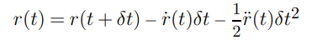
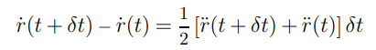
We can show that these two algorithms generate identical trajectories. Replace t with t + δt in (1):
We can rewrite (1) as:
adding these two equations we get:
The first quantity in brackets is:
and using (2) we end up with:
which is the same as the Verlet algorithm (3).

Slide 11
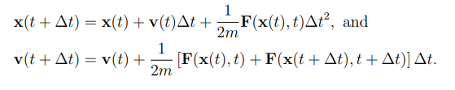
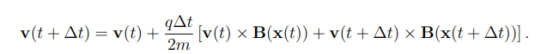
The velocity verlet method a Force F(x(t),t) will be:
For a force dependent on velocity, F(x,v,t) it would become
For a particle with charge with charge q under magnetic field B(x), the Lorentz force is F(x,v) = qv x B(x) and the above equation can be written as

Slide 12
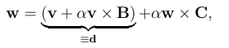
Defining some terms
v=v(t)
B=B(x(t))
w=v(t+dt)
c=B(x(t+dt))
α= q∆t/(2m)
Then previous equation becomes
and d = (v+ α v x B)
Dotting with c on both sides equation becomes w.c = d.c because w x c is perpendicular to c
Crossing equation 1 with c on both sides with c, we get
-1

Slide 13
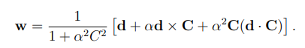
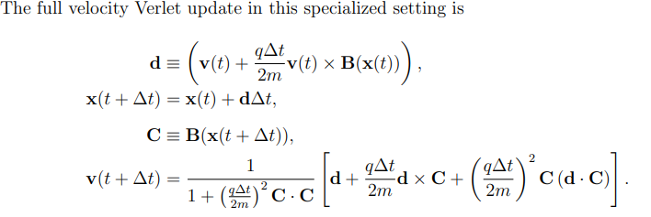
Using this value of w x c in equation 1 and isolating w we get
We get these equations by putting back values of defined terms and we just found

Slide 14
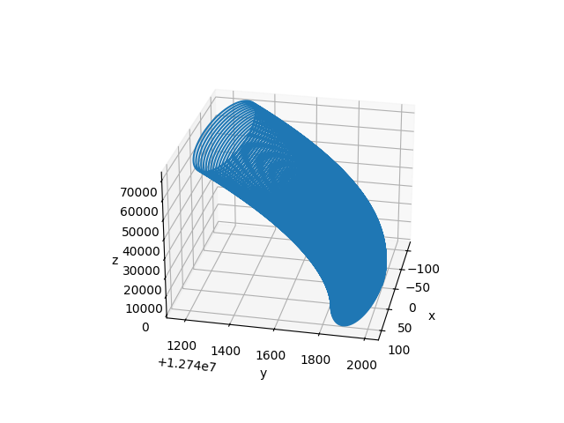
Trajectory of electron found for end time = 10^-3, electron starting from (0,2re,0)

Slide 15
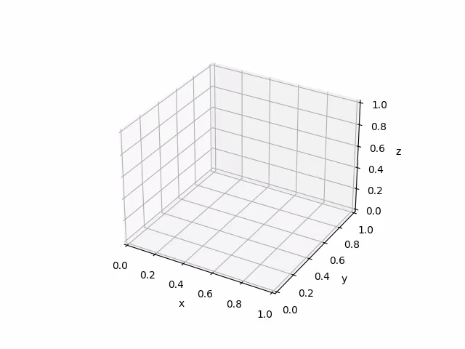
Time step dt =10^-9
End time = 10^-4

Slide 16

Time step dt = 10^-9
End time = 10^-3

Slide 17
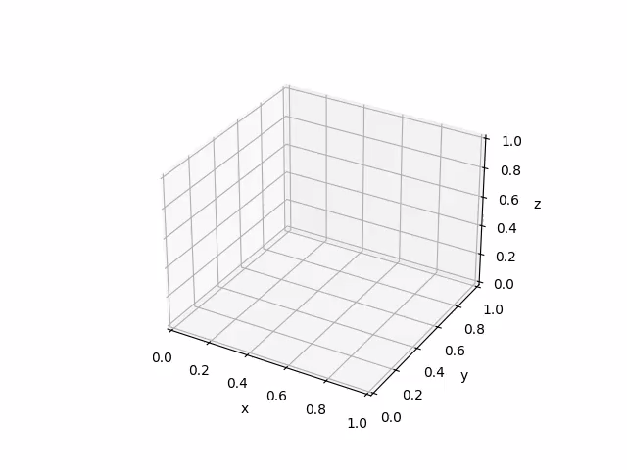
Time step dt = 10^-8
End time = 10^-2

Slide 18
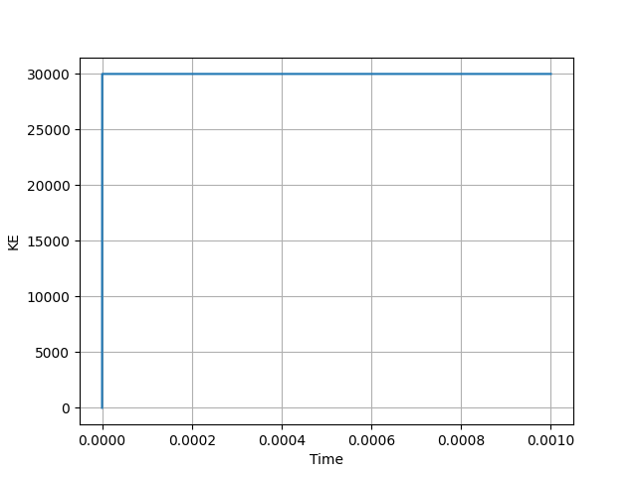
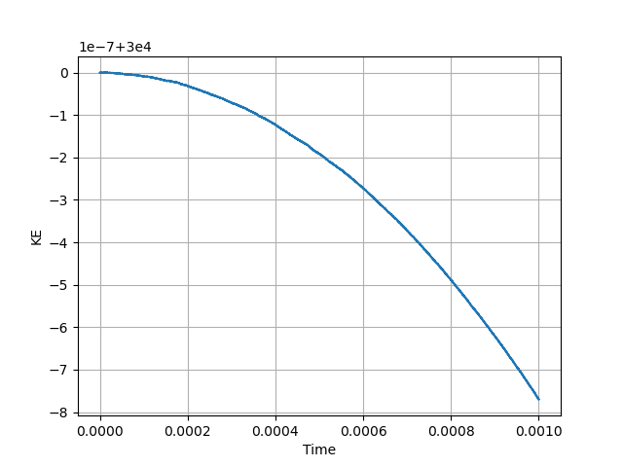
Kinetic energy vs t graph (for end time = 10^-3)
When set KE[0] = 0
When initial KE is not taken

Slide 19

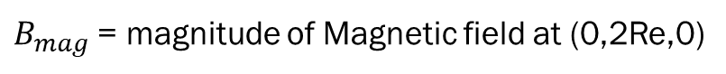
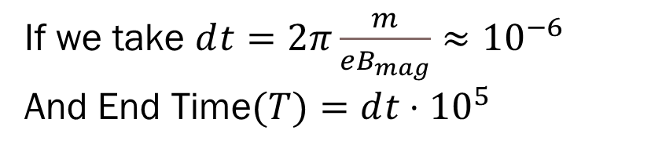
If we take $ⅆt=2π\frac{m}{eB_{mag}}≈{10}^{−6}$
And End Time$(T)=ⅆt⋅{10}^{5}$
$B_{mag}$ = magnitude of Magnetic field at (0,2Re,0)

Slide 20
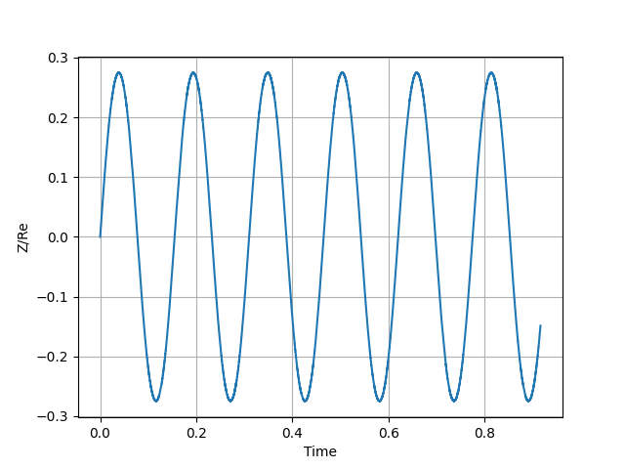
Z coordinate/Re vs t graph (for end time $T≈1$)
This tells us that electron is oscillating in earths dipole magnetic field

Slide 21
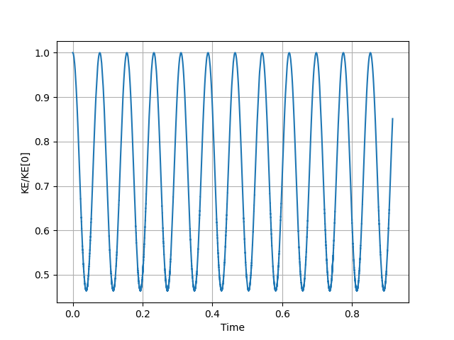
Kinetic energy/ke[0] vs t graph (for end time $T≈1$)

Slide 22
Conclusion:
In this project, we successfully simulated the motion of an electron in Earth’s dipole magnetic field using the Magnetic Velocity Verlet Method. Which demonstrated magnetic mirror effect
a phenomenon where charged particles reflect back and forth along magnetic field lines due to conservation of their magnetic moment.

Slide 23
REFERENCES
https://arxiv.org/pdf/2008.11810
https://en.wikipedia.org/wiki/Spherical_coordinate_system
https://en.wikipedia.org/wiki/Dipole_model_of_the_Earth%27s_magnetic_field
https://tonypaxton.org/Notes/MD.pdf

Slide 24
Thank you
Ramagiri JAIDHAR - EP23BTECH11021
Y VENKAT RAGHAV - EP23BTECH11035
BONU VIDYA SAGAR - EP23BTECH11006

